Slide 1
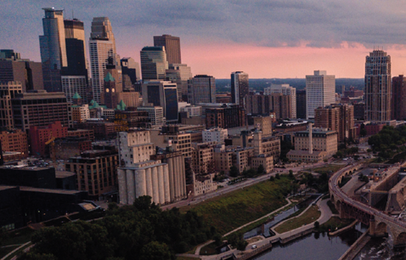
General Conference 2020
Minneapolis, Minnesota

Slide 2
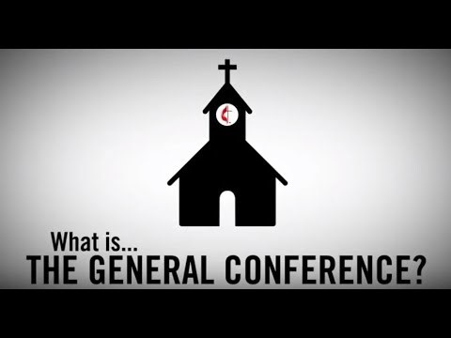
What is General Conference?
Video link

Slide 3
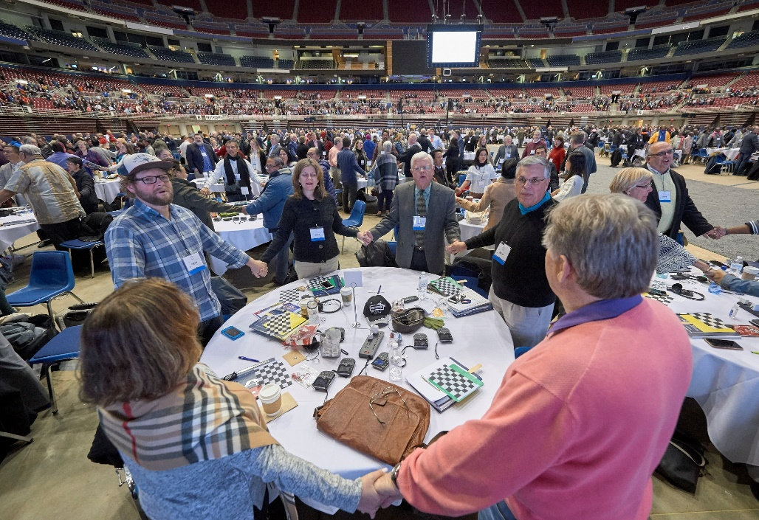
What is General Conference?
The top legislative assembly of The United Methodist Church
Meets every 4 years or when special sessions are called
Only body that speaks on behalf of the entire denomination

Slide 4
What does General Conference do?
Reviews and revises The Book of Discipline and The Book of Resolutions
Votes on changes to the church constitution, which require a 2/3 majority to pass. Amendments must be ratified by 3/4 of the total annual conference members voting.
Sets the denomination’s budget and determines ministry priorities for the next 4 years
Elects bishops to serve on boards and agencies and persons to serve on various General Conference bodies
Elects Judicial Council members

Slide 5
Who are the delegates?
The election of delegates occurs at annual conference sessions in the two years preceding a given General Conference
Each annual conference elects an equal number of clergy and lay delegates based on the number of clergy and lay members to the annual conference and a formula determined by the General Conference secretary
Clergy and lay delegates are each elected by their peer groups at the session. All elected delegates must be chosen by a majority of those voting. Multiple ballots are taken until a majority is reached.

Slide 6
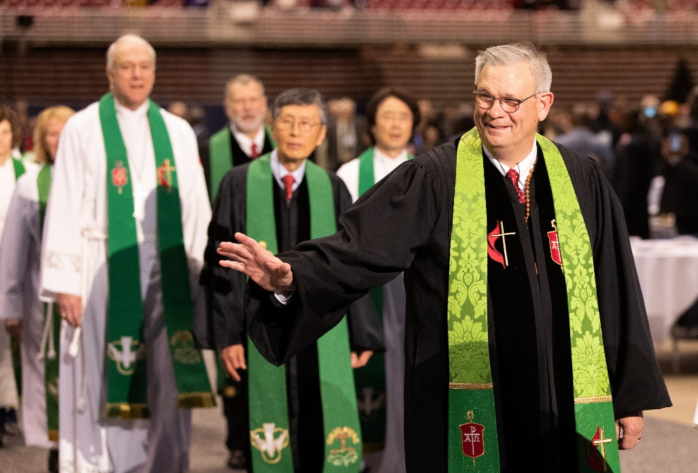
What role do the bishops play?
Bishops attend General Conference and preside over each session
However, bishops DO NOT vote at General Conference, nor can they address the body unless given permission by the General Conference

Slide 7
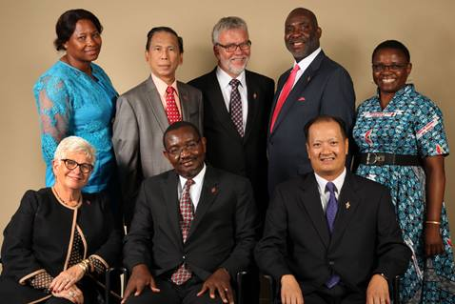
What is Judicial Council’s role?
Judicial Council is the highest judicial body of the denomination
Made up of 9 members reflecting the diversity of the denomination
Meets twice a year and can accept requests from annual conferences, church-related groups or bishops to rule on matters of church law
Rules on the constitutionality, meaning and application/effect of any act or legislation by General Conference

Slide 8
How do petitions reach General Conference?
Petitions are submitted digitally to the petition secretary at least 180 days prior to General Conference
All petitions must be signed by the person submitting them with personal information (address, email, phone number and any UM affiliations) provided
Each petition that is properly submitted is given a number and printed in the Advance Edition of the Daily Christian Advocate mailed to all General Conference delegates prior to the conference

Slide 9
What are the legislative committees?
Legislative committees are the bodies that will consider individual petitions before they are presented at the floor of General Conference
Each delegate is assigned to a committee. General Conference 2020 will have 14 legislative committees.
Each committee can recommend a petition be adopted, rejected or revised by the General Conference
A committee may also submit majority and minority recommendations to allow dissenting committee members the opportunity to share their opinion with the General Conference

Slide 10
How can I track legislation?
The General Conference website, GC2020.umc.org, will have a link where you can track the progress of specific petitions during General Conference
Petitions can be searched based on their number, keywords in the legislation, the name of the person/organization who submitted them or the legislative committees they were assigned to
Petitions are also printed in the Advanced Edition of the Daily Christian Advocate available on the General Conference website

Slide 11
Important legislation coming before General Conference 2020
Proposals for reorganization of The UMC
Proposal for a new U.S. Regional Conference
Proposal to create a new central conference in Africa and increase the number of African bishops from 13 to 18
Proposed revisions of the Social Principles by Church and Society to better reflect the public and global witness of the denomination
Proposed church budget of $493.8 million from GCFA with cuts ranging from 15.5% to 35% among general agencies

Slide 12
Important legislation coming before General Conference 2020
The Council of Bishops has called for full communion with The Episcopal Church. The Council also proposes changes to the full communion process.
The General Commission on the Status and Role of Women calls for an “Apology from the General Conference to Victims/Survivors of Sexual Misconduct with The United Methodist Church” and an update to existing resolution on “Sexual Misconduct Within Ministerial Relationships.”

Slide 13
Legislation: Treatment of Girls and Women
The General Commission on the Status and Role of Women proposes adding “gender” to the list of traits for which people cannot be barred from membership within The UMC.
United Methodist Men proposes updating a resolution supporting clergywomen urging UMM organizations to welcome women to the pulpit and participate in studies and activities of local UM Men organizations.
“The Girl Child” legislation from United Methodist Women (UMW) calls the church to engage in advocacy to rectify conditions that limit girls from reaching their fullest potential.
UMW supports legislation calling on the church to work for women’s global equality.

Slide 14
Proposed Reorganization Plans
New Denominations (Indianapolis Plan)
New Expressions Worldwide (N.E.W.)
Next Generation UMC (UMCNext)
Protocol of Reconciliation and Grace Through Separation

Slide 15
Indianapolis Plan
Proposes the establishment of 2-3 new denominations (1 traditionalist and 1 or more centrist/progressive)
The UMC would continue as the centrist denomination
Annual and central conferences vote to join any new denomination by a simple majority. Central conferences may also vote to become autonomous
Local churches may choose to be a join a different denomination from their annual conference by a simple majority vote and retain their property, assets and liabilities
Other potential denominations may be formed by 50+ local churches or an annual conference
Sets interim suspension of complaints and disciplinary actions related to LGBTQ bans within centrist-affiliated conferences
Mandatory retirement of U.S. bishops waived until 2022. New elections of bishops postponed until 2021 or 2022
Continuity of pensions through each new denomination

Slide 16
New Expressions Worldwide
Proposes dissolving The United Methodist Church to form 4 new denominations: traditionalist, centrist, progressive and liberationist
Plan of separation would be developed by a transitional council, nominated and elected by General Conference 2020
Immediate moratorium on all charges, complaints and trials related to LGBTQ prohibitions until after separation
Annual conferences, bishops, central conferences and clergy would choose to join one of the new denominations
General agencies would become independent 501(c)3 organizations
Local churches wishing to join a different denomination from their annual conference could do so with a 2/3 vote and keep all property, assets and liabilities
Each new denomination would set its own policies, structures and processes

Slide 17
Next Generation UMC
The United Methodist Church would remain, but with the current prohibitions against LGBTQ ordination and marriage removed
A moratorium on new and pending complaints and trials related to LGBTQ prohibitions would take effect in 2020
Local churches could vote by a 2/3 majority to leave the denomination and form new affiliations while retaining their property, assets and liabilities
A special commission would be established to propose a new constitution and government structures to be voted on at another special called General Conference
Calls for the creation of a U.S. regional conference and U.S. Regional Committee of the General Conference (consistent with the proposed U.S. Regional Conference plan coming from the Connectional Table).

Slide 18
The Protocol
Proposes the development of a new traditionalist denomination
The United Methodist Church would continue to exist
Churches could vote to join new denomination by either a simple or 2/3 majority.
Churches leaving The UMC would retain all property, assets and liabilities.
Annual conference could vote by a 57% majority to join new denomination
Central conferences could vote by 2/3 majority to join new denomination
Churches and conferences that do not take vote would remain in The UMC
Requests holding in abeyance all administrative and judicial processes related to LGBTQ prohibitions along with pending church closures
The new traditionalist denomination would receive $25 million over 4 years
An additional $2 million would be escrowed for possible future new denominations
$39 million would allocated over 8 years to support ethnic ministries and Africa University
Pension plans for all clergy and lay employees remain in place

Slide 19
U.S. Regional Conference
The Connectional Table has proposed the creation of a new U.S. regional conference
U.S. Regional Conference would compromise the five U.S. jurisdictional conferences, which would retain the same powers and geographic boundaries within the new regional conference
Stage 1: Creates an interim U.S. regional committee of the General Conference to handle U.S. matters
Stage 2: The U.S. regional committee would present plan for U.S. regional conference at General Conference 2024 for approval
The U.S. Regional Conference would hold its first meeting in 2024

Slide 20
Other recommended resources
General Conference 2020 website – https://www.resourceumc.org/en/churchwide/general-conference-2020
Comparison of Restructuring Plans - https://cdnsc.umc.org/-/media/umc-media/2020/01/09/19/07/General-Conference-UMC-Plans-Chart-V6
Welcome Guide to General Conference 2020 - https://cdnsc.umc.org/-/media/umc-media/2020/01/30/20/57/GC_ConferenceGuide19_digital.ashx
What is General Conference? Video - https://www.resourceumc.org/en/content/what-is-the-general-conference

