Slide 1

Jurisdictional Study Committee
Report to the U.S. Jurisdictions
February 13, 2021
Fred Brewington, JSC Chair

Slide 2
Creation
Jurisdictional Study Committee
Petitions to Change Jurisdictional Lines
Petitions to change formula on number of bishops
Petitions to change timing of changes in bishop numbers
2020 General Conference
Notes:
During the 2016 General Conference of The United Methodist Church, 23 petitions included recommendations for changes to the formula used to determine the number of bishops within jurisdictional conferences and jurisdictional boundaries in the United States.

Slide 3
Membership
Jurisdiction | Bishop | Clergy | Laity
NCJ | Frank Beard | Joy Barrett | Lonnie Chafin
NEJ | John Schol | Denise Smartt Sears | Lorene Wilbur
SCJ | Cynthia Harvey | Elijah Stansell | Susan Brumbaugh
SEJ | James Swanson | Susan Leonard Ray | Del Holley
W | Warner Brown | Jeremy Smith | Kristina Gonzalez
Chair |  |  | Fred Brewington

Slide 4
Our Mission Statement
“The Jurisdictional Study Committee will examine the current realities and missional needs of the UMC for the 21st century and recommend a process to determine the number and boundaries of the jurisdictions and episcopal areas that align with the missional priorities and common purpose of the UMC so that we live out the call of Christ as people committed to be in the Connection.”

Slide 5
How it would work
Assess Missional Needs and Capacity
College of Bishops
Juris. Episcopacy Committee
Financial Capacity of Juris
Reviews and Recommends
Interjurisdictional Committee on the Episcopacy
General Conference
Approves Funding
Notes:
1. More flexibility for the near term
2. Jurisdictional Conferences currently have the authority to determine the number, names, and boundaries of episcopal areas, subject to the General Conference's authority to fix a uniform basis for the election of bishops and provide funding for bishops so elected and the respective Colleges' of Bishops authority to arrange the plan of episcopal supervision (BOD 40; see also BOD 16 and 48, Judicial Council Decision 1312).
3. Therefore, the number, assignment, focus and support of U.S. bishops is best identified within the jurisdiction where people better understand the missional strengths, challenges and opportunities.
4. General conference determines the number of positions to fund based upon the recommendation of the IJC.
5. Funding paragraph uses the term “entitled” and the number appears in the funding paragraph.
How does ijc report?
What is role of finance committee? Of gcaf?
Is the minimum language just, shall be entitled to 5, and ijc may recommend more?

Slide 6
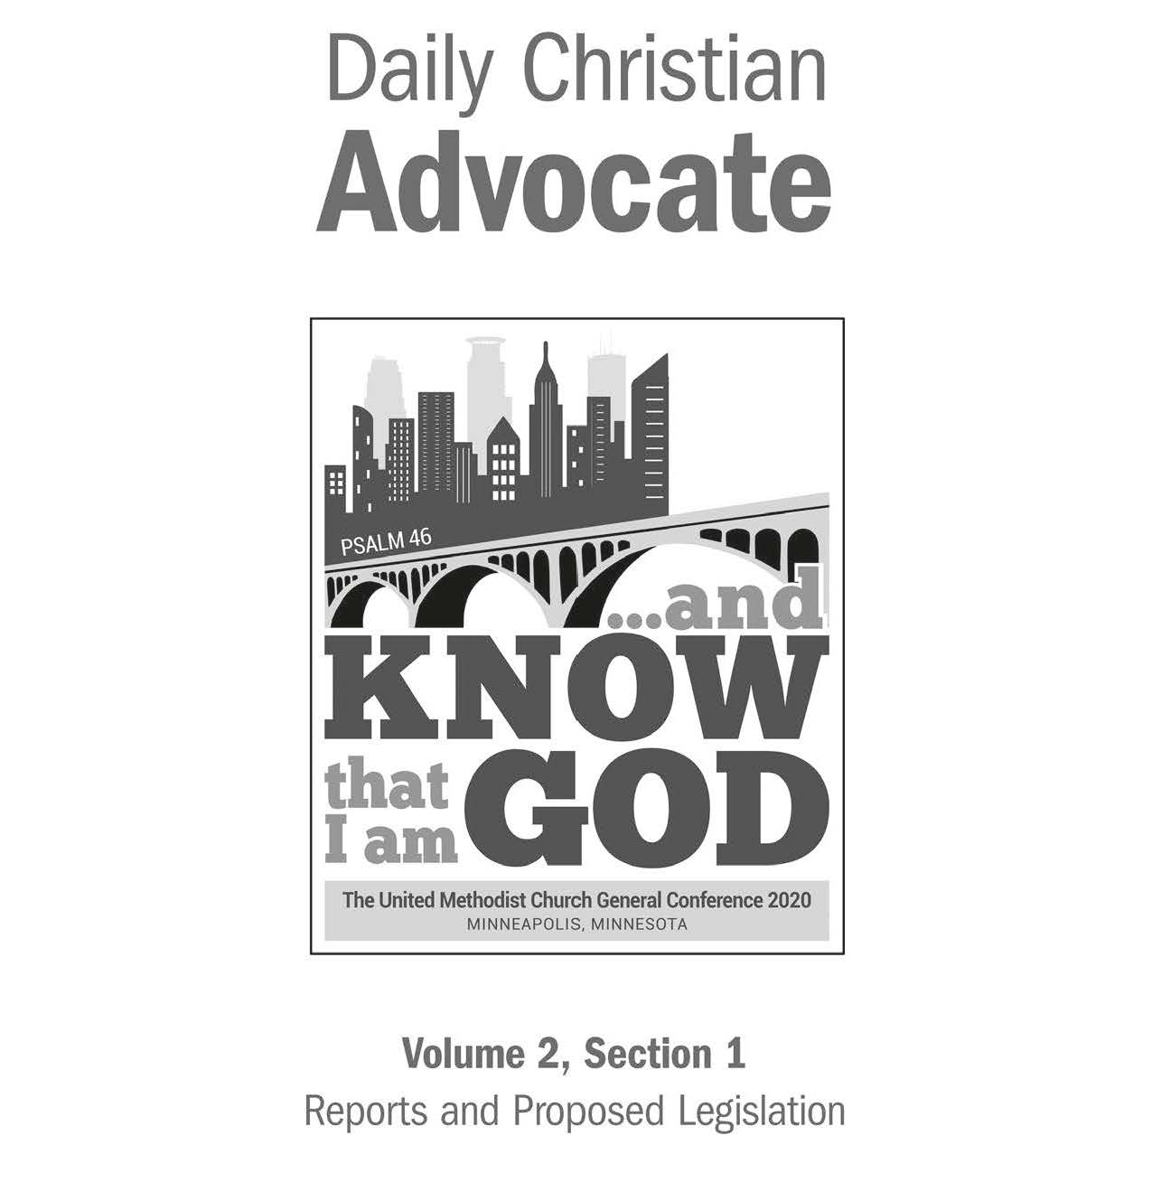
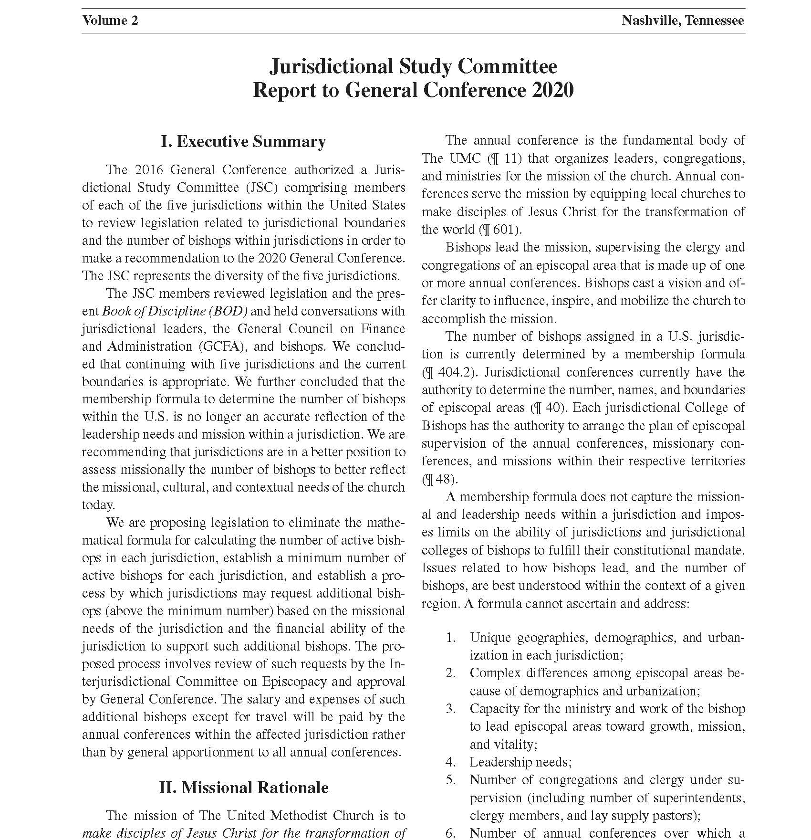

Slide 7
Jurisdictional Study Committee
Thank
You

