Slide 1
2021 Year- End Evaluation Report
United Methodist Communications

Slide 2

Organizational Goals
Engage people with the story of God’s work in the world through The United Methodist Church.
Equip The United Methodist Church at all levels to become effective communicators.
Claim our role as the strategic communications and marketing agency for the global United Methodist Church by building communication networks and infrastructure.
Nurture our people and demonstrate good stewardship of our resources.

Slide 3
Website Performance
 | Sessions 2021 | Sessions 2020 | Change in Sessions | Pageviews 2021 | Pageviews 2020 | Change in Pageviews | Pages per Session 2021 | Pages Per Session 2020 | Average Session 2021 | Average Session 2020
UMC | 5,157,203 | 4,459,719 | 15.64% | 9,903,501 | 8,728,732 | 13.46% | 1.92 | 1.96 | 1:24 | 1:32
Resource UMC | 1,410,323 | 1,038,397 | 64.07% | 2,296,378 | 1,519,259 | 51.15% | 1.35 | 1.46 | 0:55 | 1:25
UM News | 1,764,223 | 2,616,288 | -32.57% | 2,432,319 | 3,515,365 | -30.81% | 1.38 | 1.34 | 1:23 | 1:17
*Dropped UMCom; merged with ResourceUMC.

Slide 4
Newsletter Performance
Newsletter subscriptions increased by 4.9% in 2021.
Publication | 2021 Subscriptions | 2020 Subscriptions | % Change Subscriptions | 2021 Open Rate (% of Delivered) | 2020 Open Rate (% of Delivered) | Change in Open Rate (% points) | 2021 Click Rate (% of Opens) | 2020 Click Rate (% of Opens) | Change in Click Rate (% points)
UM Now | 106,146 | 99,496 | 6.7 | 31.7 | 34.6 | -2.9 | 16.1 | 18.0 | -1.9
MyCom | 49,489 | 48,780 | 1.5 | 25.3 | 29.0 | -3.7 | 8.6 | 12.7 | -4.1
Weekly/Friday Digest | 48,774 | 47,144 | 3.5 | 29.7 | 35.3 | -5.6 | 20.2 | 18.1 | 2.1
Daily Digest | 44,793 | 42,600 | 5.1 | 37.7 | 40.4 | -2.7 | 15.5 | 16.6 | -1.1
COMPASS | 22,748 | 21,496 | 5.9 | 14.4 | 18.7 | -4.3 | 7.4 | 10.2 | -2.8
The Source | 14,255 | 13,493 | 5.6 | 42.5 | 47.6 | -5.1 | 14.2 | 19.3 | -5.1
CommunicationEssentials (Leaders) | NA | NA | NA | 30.8 | 30.6 | 0.2 | 5.7 | 5.8 | -0.1
UMComtigo | 678 | 487 | 39.2 | 38.6 | 41.9 | -3.3 | 21.8 | 25.6 | -3.8
DuruAllimi | 2,035 | 1,860 | 9.4 | 46.9 | 49.9 | -3.0 | 30.9 | 29.4 | 1.5
TOTAL | 288,918 | 275,356 | 4.9 | 33.8 | 38.0 | -4.2 | 15.8 | 16.6 | -0.8

Slide 5
Social Media Channel Performance
Across all agency channels, we had 1.67 million social media followers and 6.4 million engagements. Here’s a sampling of the largest channels.
 | Facebook Followers 2021 | Facebook Engagement 2021 | Instagram Followers 2021 | Instagram Engagement 2021 | Twitter Followers 2021 | Twitter Engagement 2021 | You Tube Views 2021 | Flickr Views 2021
UMC | 711,493 | 2,877,255 | 68,675 | 555,007 | -- | -- | 763,034 | --
UMCom | 194,357 | 458,565 | 2,202 | 1,850 | -- | -- | -- | --
UM News | 224,886 | 919,555 | -- | -- | 27,681 | 14,823 | -- | 436,500
ResourceUMC | 82,187 | 170,490 | -- | -- | -- | -- | -- | --
Rethink Church | 109,049 | 314,255 | 12,879 | 19,400 | 20,032 | 1,500 | -- | --
UMC Giving | 118,275 | 1,008,337 | -- | -- | -- | -- | -- | --

Slide 6
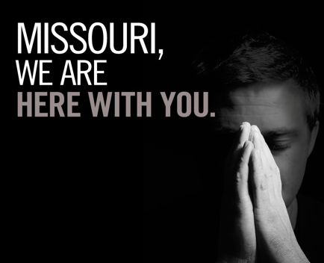
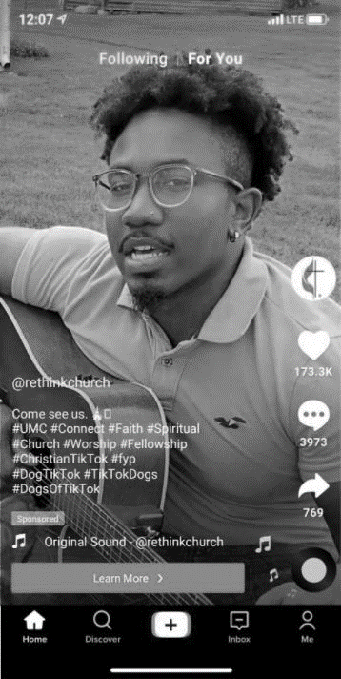
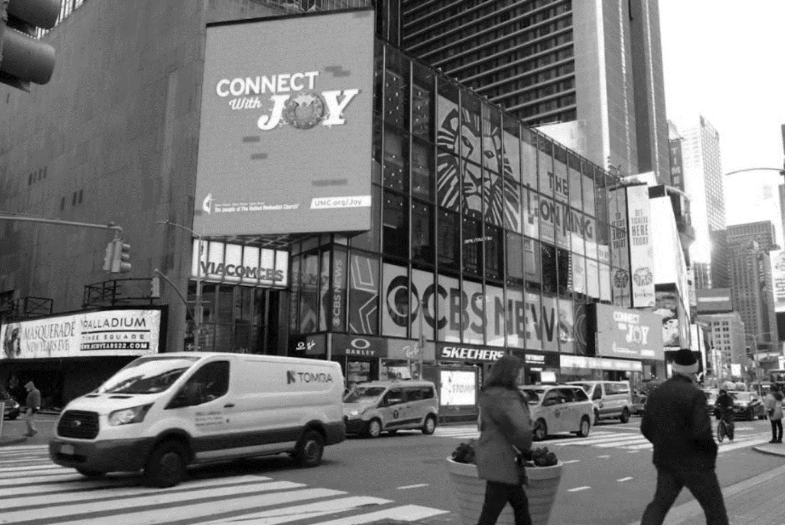
  A new Neighborly Community national advertising campaign, including Times Square and TikTok ads, took a lighthearted approach to help individuals struggling with isolation and loneliness and invited them to find meaningful connections with others through The United Methodist Church.
  Our disaster relief and national advertising campaigns garnered nearly 459 million impressions.
Advertising & Promotion

Slide 7
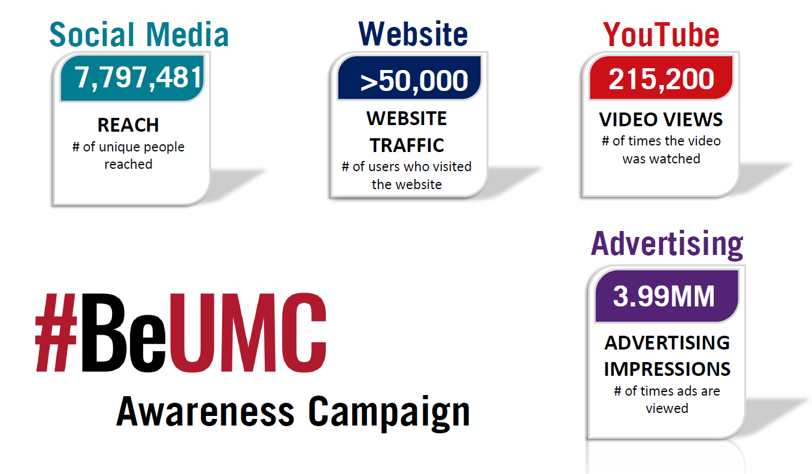
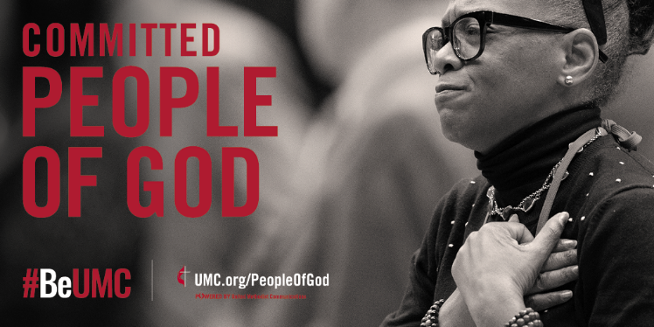
#BeUMC
Monthly themes: faithful, missional, committed, spirit-filled, deeply rooted, connected, resilient, justice-seeking and diverse
The words reflect the denomination’s faith, heritage, values, history, diversity, connection and global footprint.
Building on the People of God campaign, a #BeUMC call-to-action hashtag was introduced to invite members to embody the church’s values, embrace its aspirations and remain with The United Methodist Church even in difficult times. The grassroots campaign celebrates key attributes that are important to United Methodists and served as a reminder of how they are living out their faith.
Starting in July 2021, #BeUMC appeared on denominational advertising. Local churches, annual conferences and other United Methodist organizations were provided a collection of ready-to-use graphics and videos for use on their websites and social media channels. Churches and members were also encouraged to incorporate the hashtag as they shared their stories of faith in their own social media posts. All campaign components were designed to be customized according to context and used at all levels of the denomination.

Slide 8
 | Downloads | Page views | Conversion
Human Relations Day | 15,637 | 128,060 | 12%
UMCOR Sunday | 10,699 | 173,222 | 6%
Native American Ministries | 11,113 | 155,487 | 7%
Peace with Justice Sunday | 2,944 | 71,682 | 4%
World Communion Day | 58,065 | 129,562 | 45%
UM Student Day | 5,582 | 30,147 | 19%
Total | 104,040 | 688,160 | 15%
Special Sundays | 109,753 | 826,177 | 13.3%
Promotion of Giving | 21,752 | 6,588,426 | 0.3%
Advance | 4,256 | 628,504 | 0.7%
Total | 135,761 | 8,043,107 | 2%
Highlights
76% increase in download activity over 2020 in pastor and leader kit resources
  54K in 2020 vs 96K in 2021
33% increase in overall Special Sunday giving over 2020
  2.4M in 2020 vs 3.3M in 2021. Our efforts, alongside the efforts of the affiliated UM agencies has assisted in this increase due to amplified promotion plans
2% conversion rate on overall promotion of funds in 2021
Connectional Giving

Slide 9
Local
Church Services
  1,900+ UMC churches received marketing coaching, implementation support, and resource assistance.
  2,951+ services were provided in 2021 to the 1,900+ local churches.
  Services provided include the following: comprehensive marketing audits, social media strategy + social ad placements, website design/building + SEO, custom logo + brand development, letterhead, business card, and brochure design, customized promotional materials, and Zoom grants.
  We provided Zoom grants to 430+ churches for continued access to reach their congregations and communities throughout 2021 for worship and events for online and hybrid models.
  300 churches were resourced with UMC branded “Love Your Neighbor” masks to continue keeping one another safe while gathering for in person worship services and events
  A live Q&A for Social Media Day provided local churches an opportunity to learn and ask questions of our social media experts.
  The Local Church Services team provides website development support for churches in the Philippines and built 14 local church sites in 2021.
  The team developed MyCom articles, marketing how-to guides, webinars, training videos and podcasts to teach and coach local churches in the areas of marketing and outreach promotion.
TESTIMONIALS
“I just want to extend a huge thank you for everything the Local Church Services Team has done for us and the denomination. When the pandemic hit and we had to close the church. I asked numerous individuals about recording equipment and didn’t get any help so we were looking at what our options were. I am thanking God for how you all help the small churches.” - Dennis Kiser, Pastor, Union Chapel UMC
"The Local Church team is so inventive and has an edge-cutting approach in their delivery and training which made my experience wonderful.” - Rev. Dr. Johnson, Pastor, Beaumont UMC
“We are so thankful for your help and guidance. I appreciate your help so much and look forward to seeing how these social media ads make a difference in what we’re doing here in Sahuarita. I don’t know what we would have done without your help!” - Sandy Johnson, Senior Pastor, Santa Cruz Valley UMC

Slide 10
Local Church Services Marketing
Grants and Services Offered | Jan-Dec
ZOOM Grants + Licenses | 428+
Easter, Fall and Advent Customized Promotional Resources | 1,143
MissionInsite Reports | 183
Re-opening Church Customized Promotional Resources | 194
How To Guides / Educational Resources | 117
UMC Face Mask Grants | 294
Branding / Logo Services | 172
Website Development Packages + Services | 125
Social Media Services | 170
Technology Solutions – Mevo Cameras & FM Transmitters | 25
New Church Start / Relaunch Outreach Packages + Miscellaneous Customized Promotional Resources | 40
Other Services | 13

Slide 11
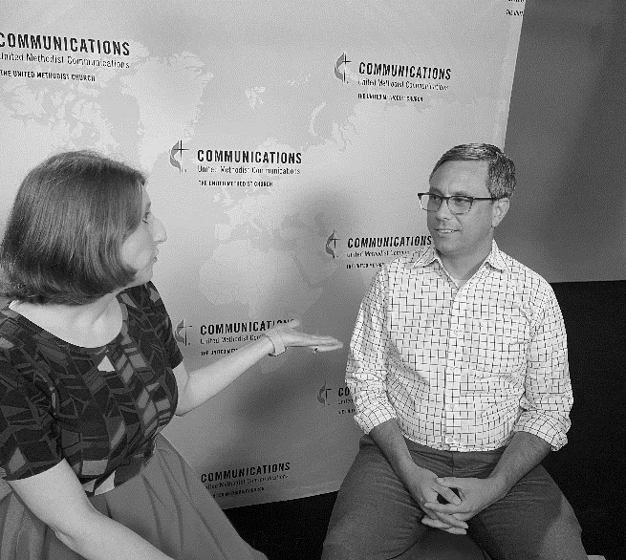
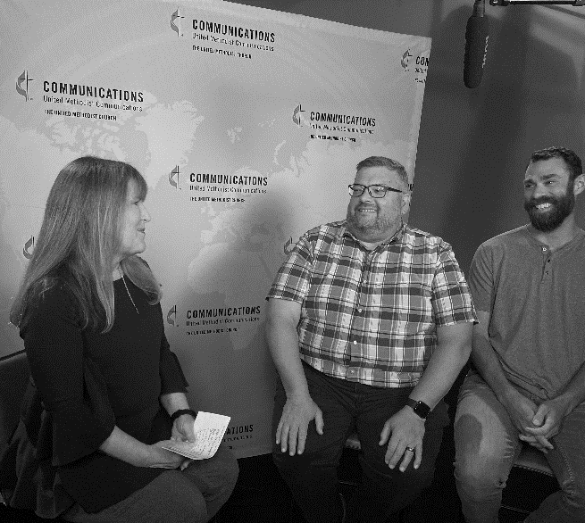
Expanded visibility and awareness of the church through news media pitching to international, national and local outlets
Wrote and distributed 39 press releases, 8 feature stories and 4 digital lounge episodes
Worked collaboratively with other UMCom teams and church entities, providing public relations expertise for at least 35 projects
Based on a value of $1 per engaged user, $1 per link click and $.005 per impression, the total generated value of Facebook pages managed by the PI team was $4,308,113 for the year 2021.
Public Information

Slide 12
Project | Client | Tracked Hours
“#BeUMC” Campaign | Marketing and Advertising | 529.86
2022 National Ad Campaign Development | National Campaign | 505.57
“I Give” Campaign | Connectional Giving | 321.08
“End Racism” Campaign | Marketing and Advertising | 272.37
UMCom Fundraising | Foundation/Marketing | 245.70
2021 Back to Church Campaign | National Campaign | 213.75
2021 National Ad Campaign Development | National Campaign | 187.58
Strategic Planning | General Secretary | 157.86
Tuesdays at the Table | CT/Marketing and Advertising | 129.33
2021 Advent Campaign | National Campaign | 116.50
Communication Essentials emails | Marketing and Advertising | 112.42
Ministry Relief Videos | Connectional Giving | 98.75
Resource UMC 2021 Digital Ads | Marketing and Advertising | 98.20
National Storyteller’s Day | Marketing and Advertising | 79.58
“Bridges of Unity” Campaign | COB/Marketing and Advertising | 79.47
Annual Report | Public Information | 70.87
Highlights
Campaigns comprised a large part of the team’s work in 2021. The team spent significantly more time on national advertising than in the past, the majority of which was new concept development and video production time.
Out of 252 projects, 71 clients completed project satisfaction surveys, with a 100% satisfaction rating.
The team generated approximately $21,000 in revenue.
Creative Strategy

Slide 13
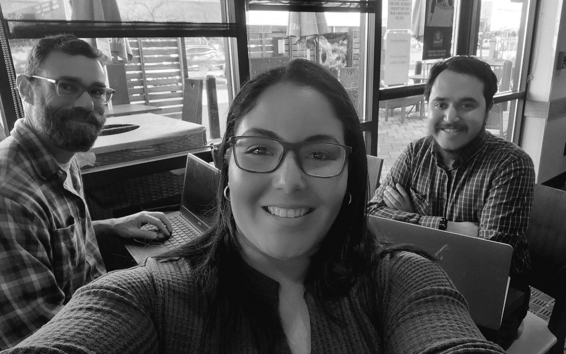
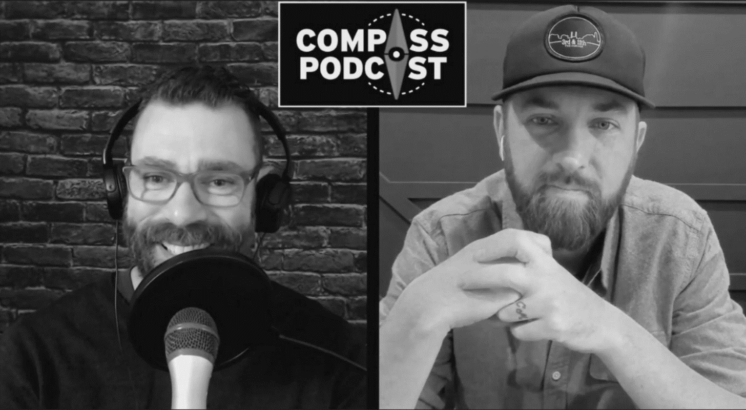
Seeker Communications includes multi-lingual outreach through advertising and seeker communication channels.
Articles:
61 original English
197 Spanish (originals and backdated translations)
166 Portuguese (backdated translations)
102 French (backdated translations)
43 Korean (backdated translations)
26 podcast episodes
Social media content:
48 prayer videos and 17 unique social media videos
TikTok Advent combined exposure of 1,873,000
Compass Podcast
22,748 subscriptions
Seeker
Communications

Slide 14
Collaboration:
Collaboration was a key component of developing member content this past year. These projects included a series of Tuesdays at the Table conversations by the Connectional Table, a collection of 11 video devotions by our United Methodist bishops, interviews with missionaries in support of United Methodist Global Ministries’ Give Love end-of-year giving campaign and a partnership with the General Commission on Archives and History to promote events in England and the U.S. celebrating the 250th anniversary of Francis Asbury’s historical journey from Bristol to Philadelphia.
Story Content:
Other highlights from the year included stories about church outreach during the COVID pandemic, the 100th episode of the Get Your Spirit in Shape podcast on International Podcast Day and a look back at the September 11 tragedy 20 years later.
Language Offerings:
Throughout 2021, the Member Communications Team increased production of content in Spanish, French, Korean and Portuguese. Users will note that UMC.org’s homepages in every language are now presenting consistent messaging.
The Member Communications Team worked with others across the church to provide a diverse array of multimedia content on UMC.org in 2021.
Member Communications efforts resulted in:
114 new pieces of content
15.6% increase in UMC.org sessions
9,903,501 page views
235,541 Non-English language page views
Member Communications

Slide 15
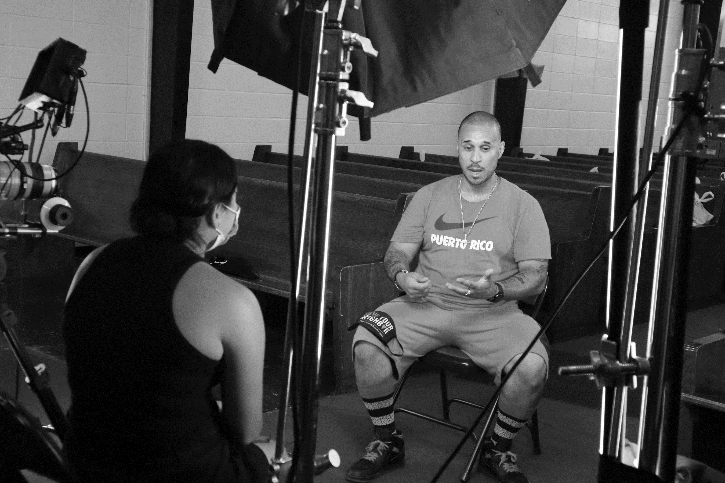
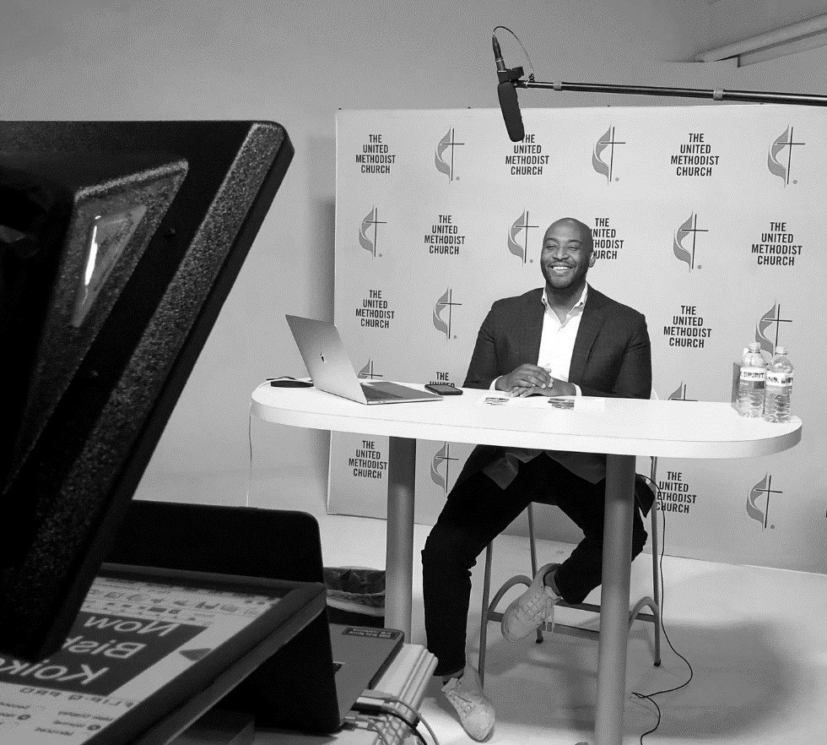

The Leader Communication Team provides engaging, effective, and exclusive content and resources to support church leaders through ResourceUMC.org and its associated channels.
116 pieces of original content across English, Spanish and Korean audiences
Republished over 100 pieces of existing content from other agencies
Launch of Pastoring in the Digital Parish podcast
Projects:
  Imagining the Future
  Emerging Methodism
  Content for State of the Church
14,255 subscribers - The Source newsletter
1.86 million page views
444% increase in traffic to ResourceUMC.org/es and a 619% increase in users who have their browser language set to Spanish
Leader Communications

Slide 16
The demand for video production services surged as people sought to stay connected virtually. Our production team adapted to meet the associated challenges to execute:
238 total projects
5,000+ hours of staff/equipment time
United Methodist Communications' state-of-the-art studios and production team supported local churches, annual and jurisdictional conferences, and other boards and agencies through the strategic use of video to deliver stories of the church and its people.
Completed projects for 22 church entities
Sampling of projects includes:
  Connectional Table’s Tuesdays at the Table
  State of the Church report
  Abingdon Press Bible studies
  Educational and training videos
  Denominational advertising campaign spots
  UMC.org / ResourceUMC.org video content
  Forums and livestreamed events
  Webinars
The Kingswood Productions arm provided production services to 28 outside organizations to generate additional revenue for communications ministry.
Production Services

Slide 17
Top 10 Training Courses | # trained
Leveraging Communication for Greater Connection | 253
What It Means to be United Methodist | 189
Moving the Church Forward Through Communication | 114
Developing A Strategy for Communications Planning | 94
Communicating During Seasons of Change | 72
Capturing Better Smartphone Photos | 71
In 2021, the Training Team introduced four new avenues of training to help leaders flourish through communications: two facilitated courses (Developing a Strategy for Communication Planning, Communicating During Seasons of Change) and two ecumenical communication conferences (Leveraging Communication, Moving the Church Forward through Communication). The conferences attracted 700 participants from eight denominations, all looking to adopt innovative communications and learn best practices for effective church communications.
A total of 2,000 persons were trained during 2021.
Social Media For Churches | 34
Video Editing for Churches | 32
Leading Remote Worship | 31
Welcoming Ministry | 29
Total | 919
Training

Slide 18
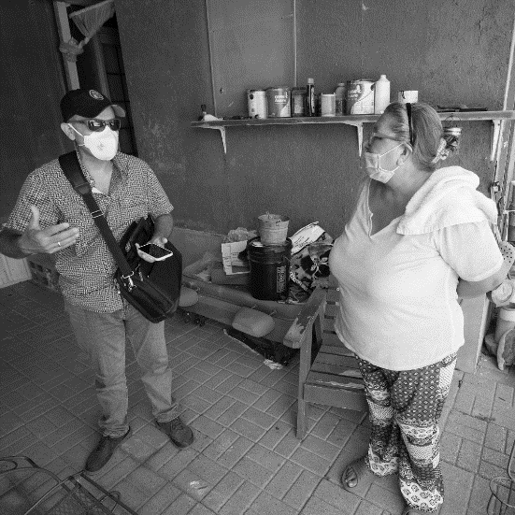

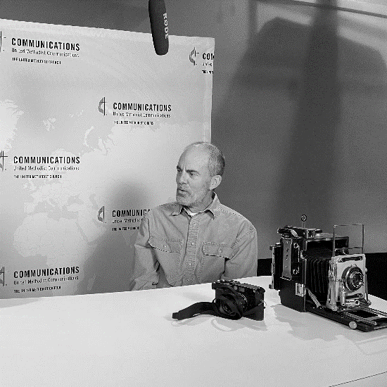
UM News
UM News focused on four major areas of coverage in 2021: The future of the church, the church’s response to the pandemic, efforts to confront and dismantle racism, and uplifting features of United Methodist individuals and congregations transforming the world through their faith.
UM News produced more than 800 original pieces of news content during the year in English, Spanish, Korean, Portuguese and French, and aggregated hundreds of stories from around the church through the UM News Daily Digest. Commentaries on a wide range of topics provided a place for a dialogue of ideas, and a new feature invited people to share personal stories about encounters with racism.
Viewership outside the U.S. grew, most notably in South Korea. A new Friday Digest replaced the former UM News Weekly Digest with a more compelling, visually attractive and easy-to-read weekly e-newsletter, and the frequency of the Korean e-newsletter, DuruAllimi, was changed to weekly.

Slide 19
ENGLISH WEB STATS
Quarter | Number of Stories | Total Page Views | Average Time on Page
Q1 | 90 | 375,345 | 3:47
Q2 | 90 | 327,508 | 3:40
Q3 | 95 | 299,422 | 3:05
Q4 | 80 | 270,814 | 3:46
Total | 355 | 1,273,089 | 3:34.5
SPANISH WEB STATS – For Year 2021
Number of Stories | Total Page Views
199 | 266,228
KOREAN WEB STATS – For Year 2021
Number of Stories | Total Page Views
164 | 186,549
PORTUGUESE WEB STATS – For Year 2021
Number of Stories | Total Page Views
140 | 34,181
Four multimedia feature stories utilizing Adobe Spark garnered 40,000 page views.
Priority coverage areas (all languages):
Breaking news/features: 430
Future of the church: 181
Ministry amid the pandemic: 123
Response to racism: 97
FRENCH WEB STATS – For Year 2021 (increased emphasis during second half of year)
Number of Stories | Total Page Views
29 | 11,509
UM News

Slide 20
Responded to over 10,000 requests:
  8,233 emails
  3,013 live chat requests
  69 phone calls
Produced eight-part series on death & resurrection, which resulted in the highest-viewed content on UM News for the entirety of 2021
Introduced new series: Pioneers in Methodism – includes oft-forgotten Methodism figures in history including Black women and Korean clergy
Most-viewed Ask the UMC FAQs for 2021:
  What is Lent and why does it last 40 days?
  What happens after a person dies?
  What is Pentecost?
Ask the UMC

Slide 21
Technology and
Customer Experience
Mapping issues affecting the Find-A-Church and My Portal services were resolved. This included manually finding missing physical addresses for nearly 500 churches.
Introduction of the Crisp online chat tool enabled web visitors to make inquiries via UMC.org, ResourceUMC.org, UMNews.org and UMChurches.org, thus increasing inquiries by more than 400%.
The Web Ministry Team partnered with the General Commission on the Status and Role of Women to relaunch the UM Sexual Ethics website and began work on their agency site.
UMCom launched its My Portal, which helps people get the most relevant information. Church leaders, staff, volunteers and lay-leaders can update their contact information, job roles, interests, newsletter subscriptions and connections to local churches and other UMC agencies and entities. Users updated 70 clergy roles and around Christmas, the site received 273,000+ page views, spending an average time of 1.20 on page.

Slide 22
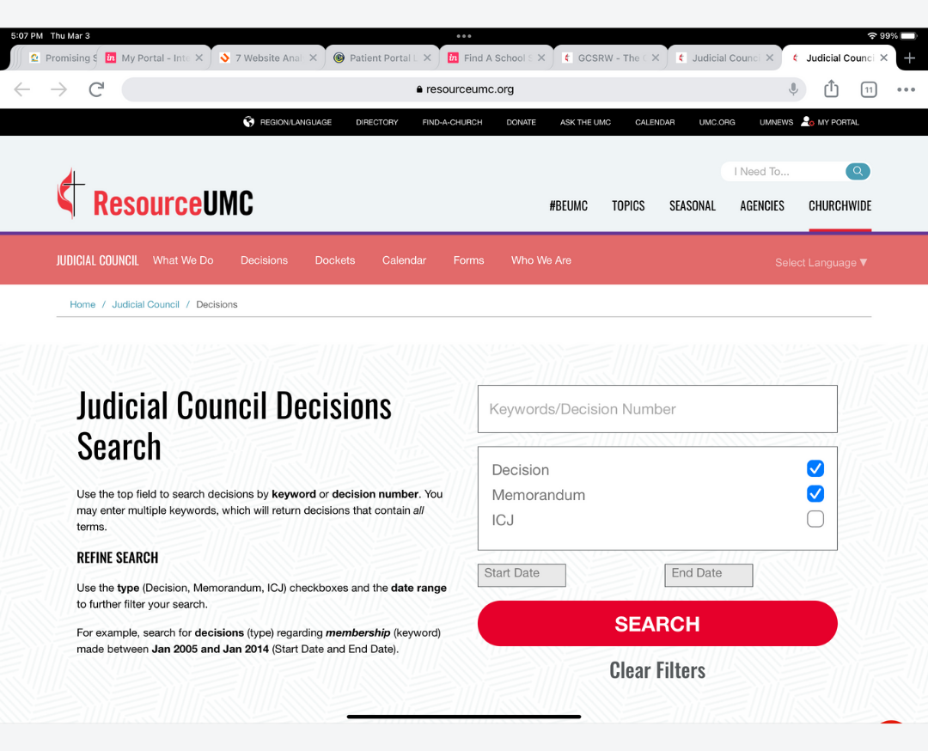
ResourceUMC.org now provides search capabilities for information on Judicial Council decisions..
Web hosting services saw an increase of sales by $7,931.67. We improved communication about and the workflow for delivering secured sites. By providing SSL for all clients, we kept their internet connection secure and safeguarded sensitive data.
A PowerBI metrics dashboard relaunch equips UMCom staff to track engagements with our content and services.
Technology

Slide 23
UMConnect:
900,241 messages
were sent or received on the platform.
Reached people with important church news updates, lifesaving health messaging and more.
Mapping:
After pausing due to COVID-19 concerns, mapping in the Philippines resumed as vaccines became available to mappers. Other mapping stayed dormant to ensure mapper safety.
Radio / United Methodist Radio Network:
Expansion of Voice of Hope radio with a second station site established with help from UMCom
Groundbreaking of a radio station in Nigeria
Relaunch of Radio Lokole in Kinshasa, DRC
UMConnect | 2021 Messages | 2020 Messages | Increase from Prior Year
Total sent & received messages | 900,241 | 537,311 | 362,930
Global Communications Technology

Slide 24
Build Relational Bridges:
Engaged parties to pave the way for cordiality and resumption of projects. Completed a stakeholder analysis. Engaged church leaders where there has been lack of trust, such as in East Africa, West Angola, and DRC. Informed bishops and their leaders regarding benefits of specific UMCom services for the common good.
Nurture Relationships:
Worked with leaders to foster accountability and transparency for successful UMCom- sponsored projects in East Africa, Angola, Nigeria, Zimbabwe, Mozambique, DRC and the Philippines. Guided UMCom teams to be protocol sensitive as context dictates.
Assess Needs:
Identified equipment and training needs for South Africa, Burundi and South Congo for radio and television evangelization.
Central Conference Relations Presence & Support

Slide 25
Provided financial sponsorship support to 6 annual conferences and 8 denominational wide events.
  6 annual conferences
  8 UMC events
Distributed U.S. conference resource support to assist local churches and annual conferences with communication needs:
  6 annual conferences
  8 UMC events
  15 virtual annual conferences
  7 hybrid annual conferences
  16 virtual UMC events
  2 hybrid UMC events
  2 in-person UMC events
Supplied agency representation to 6 UMC organizations to increase knowledge of services provided by UMCom:
  Religion Communicators Council
  Southeastern Jurisdiction Black Methodists for Church Renewal
  General Black Methodists for Church Renewal
  Black Staff Association
  Strengthening Black Churches for the 21st Century
  Oklahoma Indian Missionary Conference
U.S. Conference Relations
Presence & Support

Slide 26
We leveraged our Ethnic Leader Engagement Panels to raise awareness of ways to connect with diverse audiences.
The Member Perspectives Study helps the agency understand how members are navigating the pandemic, attitudes about the UMC and social issues.
Our Spiritual Seeker Study reveals key learnings about this group to guide our marketing and communication efforts.
After more than 10 years, the MyCom Newsletter Evaluation results indicate 90% are satisfied and 80% say it is the best source for communication tips and tools.
Research provides the grounding for our work at UMCom, allowing us to understand attitudes, behaviors, needs, motivation, media habits, audience segments and more, leading to the development of the most relevant content.
The Research Team completed 11 projects to inform the work of the agency.
These projects employed qualitative and quantitative methodologies.
These studies represent almost 5,000 interactions with our constituents – leaders, members, seekers and UMCom staff.
UMCom Research collaborated and consulted on six projects for church leadership entities.
Research

Slide 27
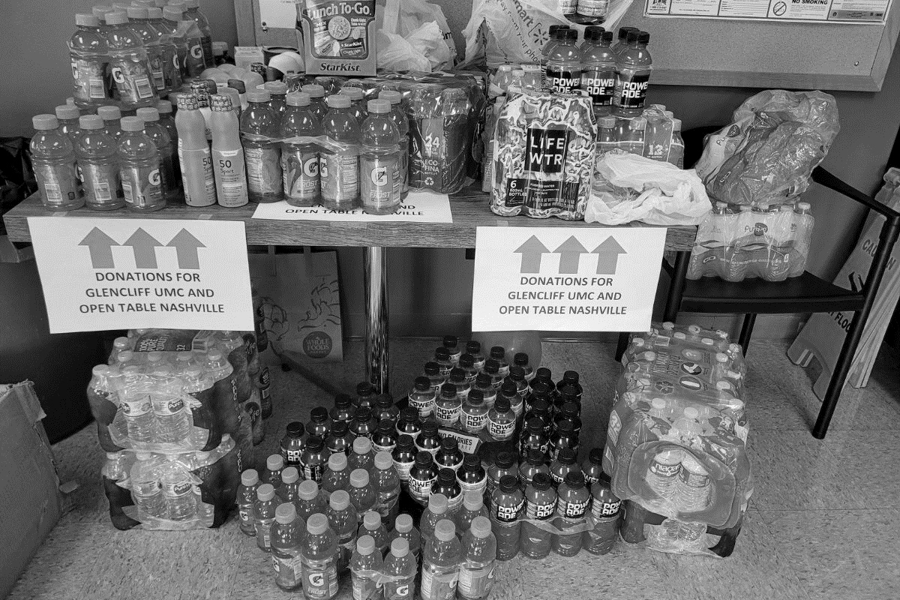
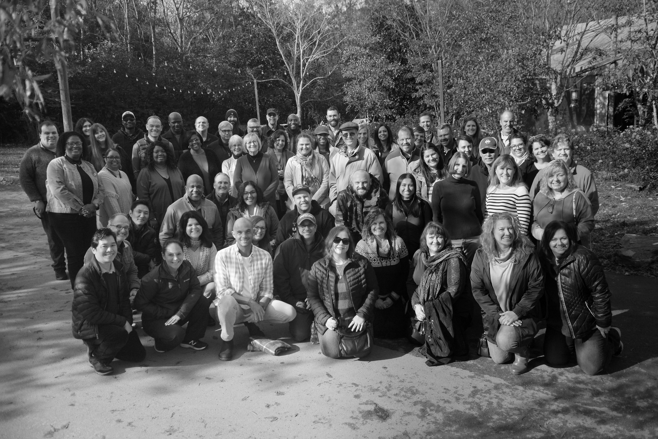
Currently, 90% of our staff are regularly working from home.
Our retention rate is above average. Five staff members retired in 2021, and we had three new hires.
Supervisors participated in and completed a full year of Rapid Learning modules.
Staff participated in 107+ trainings using LinkedIn Learning modules and were offered $2,500 in continuing education funds.
Sixty staff participated in the wellness initiative.
100% of staff completed open enrollment on time.
Outreach efforts:
  In observance of National Give Something Away Day staff provided donations to assist Open Table Nashville and Glencliff UMC to assist homeless communities during the summer heat.
  At Christmas, gifts were donated to encourage the children in care at Monroe Carell, Jr. Children's Hospital at Vanderbilt.
Human Relations

